Slide 1
STRUCTURED PRODUCTS
A structured product, also known as a market-linked investment, is a pre packaged investment strategy based on:
A single security
A basket of securities
Options, Indices, Commodities, Debt issuance or Foreign currencies
Derivatives.

Slide 2
DERIVATIVES
A derivative is a financial security with a value that is derived from an underlying asset or group of assets.
The derivative itself is a contract between two or more parties based upon the assets. Its price is determined by fluctuations in the underlying asset.

Slide 3
Equity Linked Note (ELN)
An Equity-Linked Note is issued at a discount to the Principal Amount
The difference between the amount investors pay and the amount received at maturity is the investor’s profit, and is reflected in the annualized yield
If at Valuation Date the underlying stock price remains above or equal to the Strike Price at inception, investors receive 100% of the Principal Amount at maturity
If the underlying stock performs below the Strike Price, investors are exposed to the stock’s negative performance

Slide 4




How ELN Works?
•
Choose your
Stock, Strike
•
Client pays a
•
Principal
Trade
price
Settlement
discount to
Valuation
Amount:
Date
•
Place your
Date
Principal
Date
Cash or
order with
Amount
Shares?
Products
Desk
1
If the stock price closes
•
Products Group sends
AT or ABOVE its
your TR a daily list of stock
Strike
names and yields.
Price
on Valuation Date,
•
Please contact your TR for
client gets back Principal
Amount in
that list.
cash
•
We are able to
customise
2
terms and stocks to suit
If the
stock price closes
below its
Strike Price
your needs.
on
Valuation Date,
client
gets back
Principal
Amount
in
shares
Client pays a discount to Principal Amount and gets back 100% of
Principal Amount
on Maturity.
The difference is the client’s profit, and is reflected in the quoted annualised yield.
Pick the stock you like, at the price you don’t mind collecting (the strike price).
Customise your own stock, tenor & strike price.

Slide 5
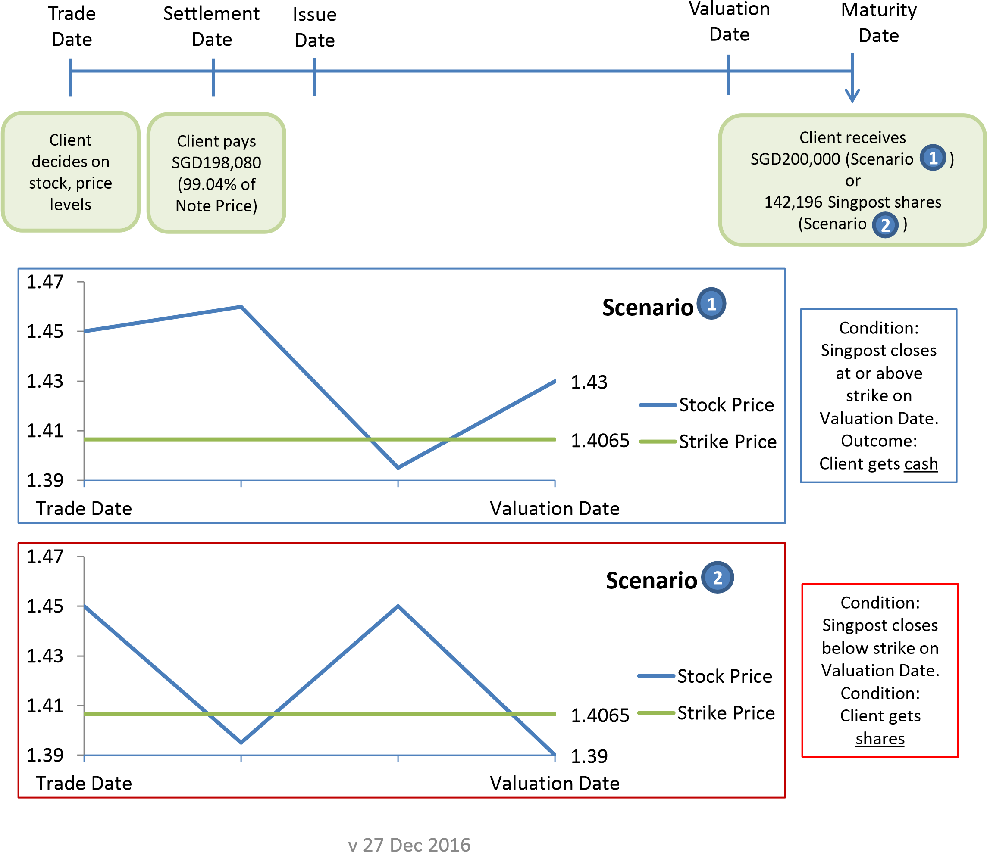
COUNTER | Singpost
Spot Price | SGD1.45
Strike Price (97% of Spot Price) | SGD1.4065
Principal Amount | SGD200,000
Client pays | SGD198,080
Yield pa | 11.16%
Trade Date | 21 Nov 2016
Settlement Date | 25 Nov 2016
Issue Date | 28 Nov 2016
Valuation Date | 27 Dec 2016

Slide 6







How KO-ELN Works?
1
If stock trades AT or ABOVE Knock
Anytime from
-
Out
Trade Initiation
Price
, client gets back
Principal Amount in
to
Valuation
cash
on Issue Date + 4 or Knock Out Date
Date
+
4, whichever is later
•
Choose your
•
Client pays
Valuation
Trade
Stock, Strike
Settlement
a discount
Date, if
•
Principal Amount:
Knock
Price, Knock
-
Out
Cash or Shares?
Date
Out Price
-
Date
to Principal
has not
Amount
occurred
2
If the stock price closes AT or
•
Products Group sends
ABOVE its
Strike Price
your TR a daily list of stock
on
names and yields.
Valuation Date, client gets back
Principal Amount in
•
Please contact your TR for
cash
that list.
3
•
We are able to
customise
If the
stock price closes below its
terms and stocks to suit
Strike Price
on Valuation Date,
your needs.
client gets
back Principal Amount
in
shares
Client pays a discount to Principal and gets back 100% of Principal on Maturity
or earlier
if there is a Knock
-
Out.
The difference is the client’s profit.
Pick the stock you like, at the price you don’t mind collecting (the strike price).
Customise your own stock, tenor & strike price.

Slide 7
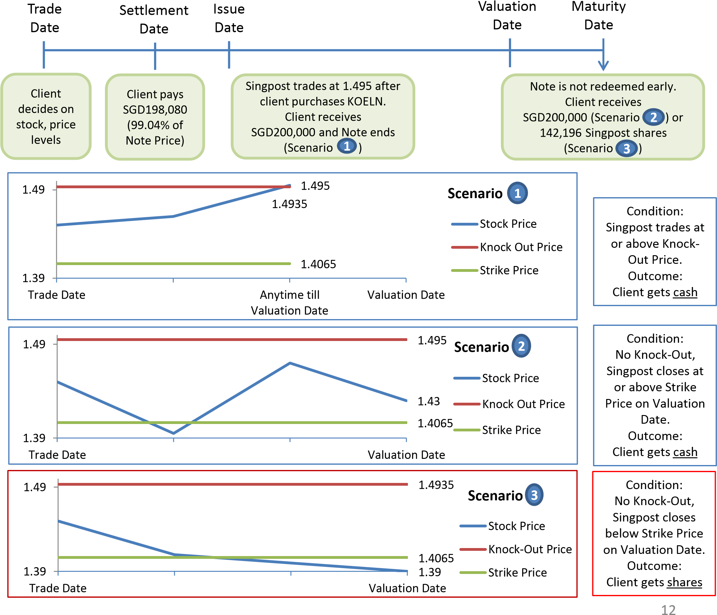
COUNTER | Singpost
Spot Price | SGD1.45
Strike Price (97% of Spot Price) | SGD1.4065
Knock-Out Price (103% of Spot Price) | SGD1.5225
Principal Amount | SGD200,000
Client pays | SGD198,080
Yield pa | 11.16%
Trade Date | 21 Nov 2016
Settlement Date | 25 Nov 2016
Issue Date | 28 Nov 2016
Valuation Date | 27 Dec 2016

Slide 8
Benefits :
Enjoy higher returns than a direct investment in the underlying stock, in the event that the stock price trades sideways
Chance to realise profits early in the event market is bullish
Chance to buy the underlying stock at a discount to market price
Risks :
ELNs are not principal protected
Gains are limited to the yield of the ELN
Investors are exposed to credit risk of the issuer and the market movement of the underlying stock

Slide 9
FIXED COUPON NOTES
An FCN is issued at par, and the investor receives coupon payments until redemption or maturity.
It is a basket product, and the baskets are generally of 2-4 shares.
In case of a Knock-out on any valuation date, the client receives 100% of the principal and the latest coupon payment.
If the worst share of the basket performs below the strike level on any of the intermediate valuation dates, the client doesn’t receive any coupon for that period.
If the worst share of the basket performs below the strike level on the final valuation date, the client receives shares of the worst performing underlying at the strike price.

Slide 10
Knock-In is a safety feature for the client. If the worst performing underlying never trades below the Knock-In level, the client will never receive shares.
However, as you lower your knock-in level, the product becomes less riskier, and hence, pricier.

Slide 11
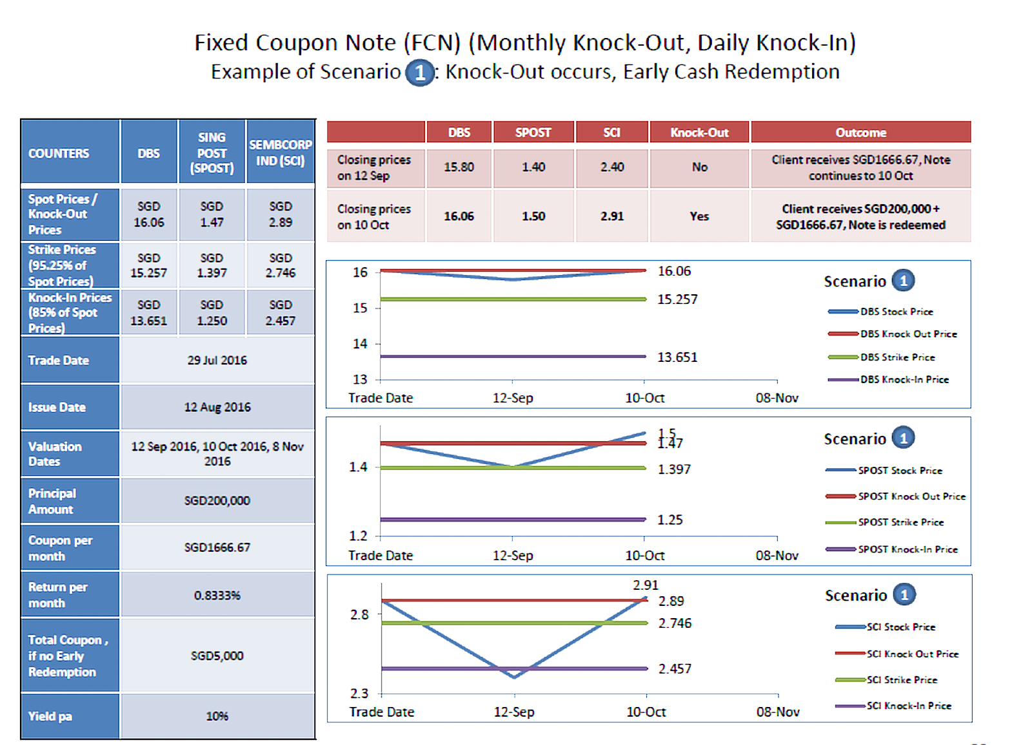

Slide 12
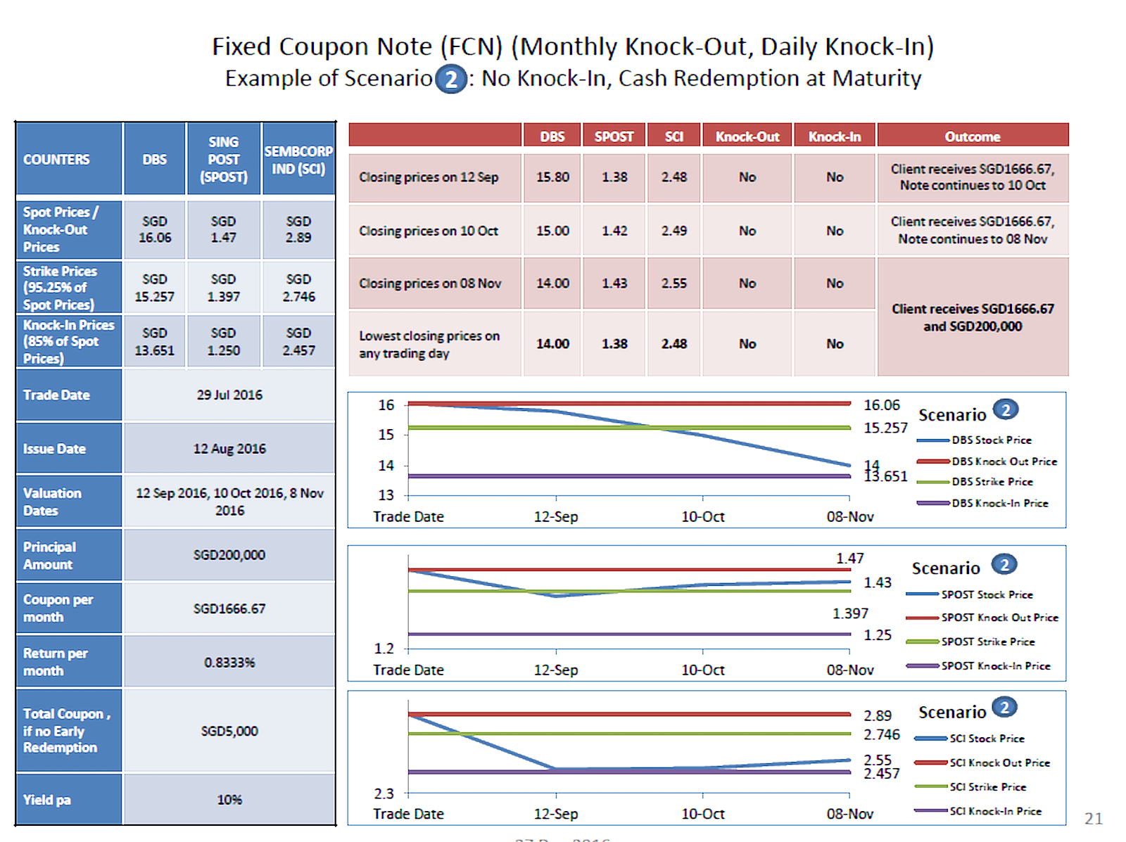

Slide 13
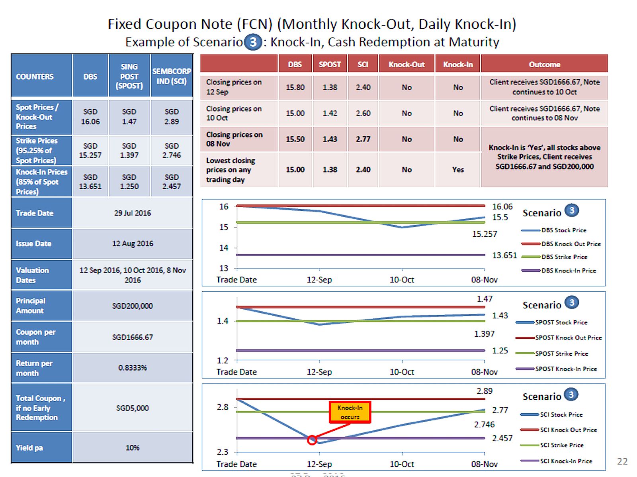

Slide 14
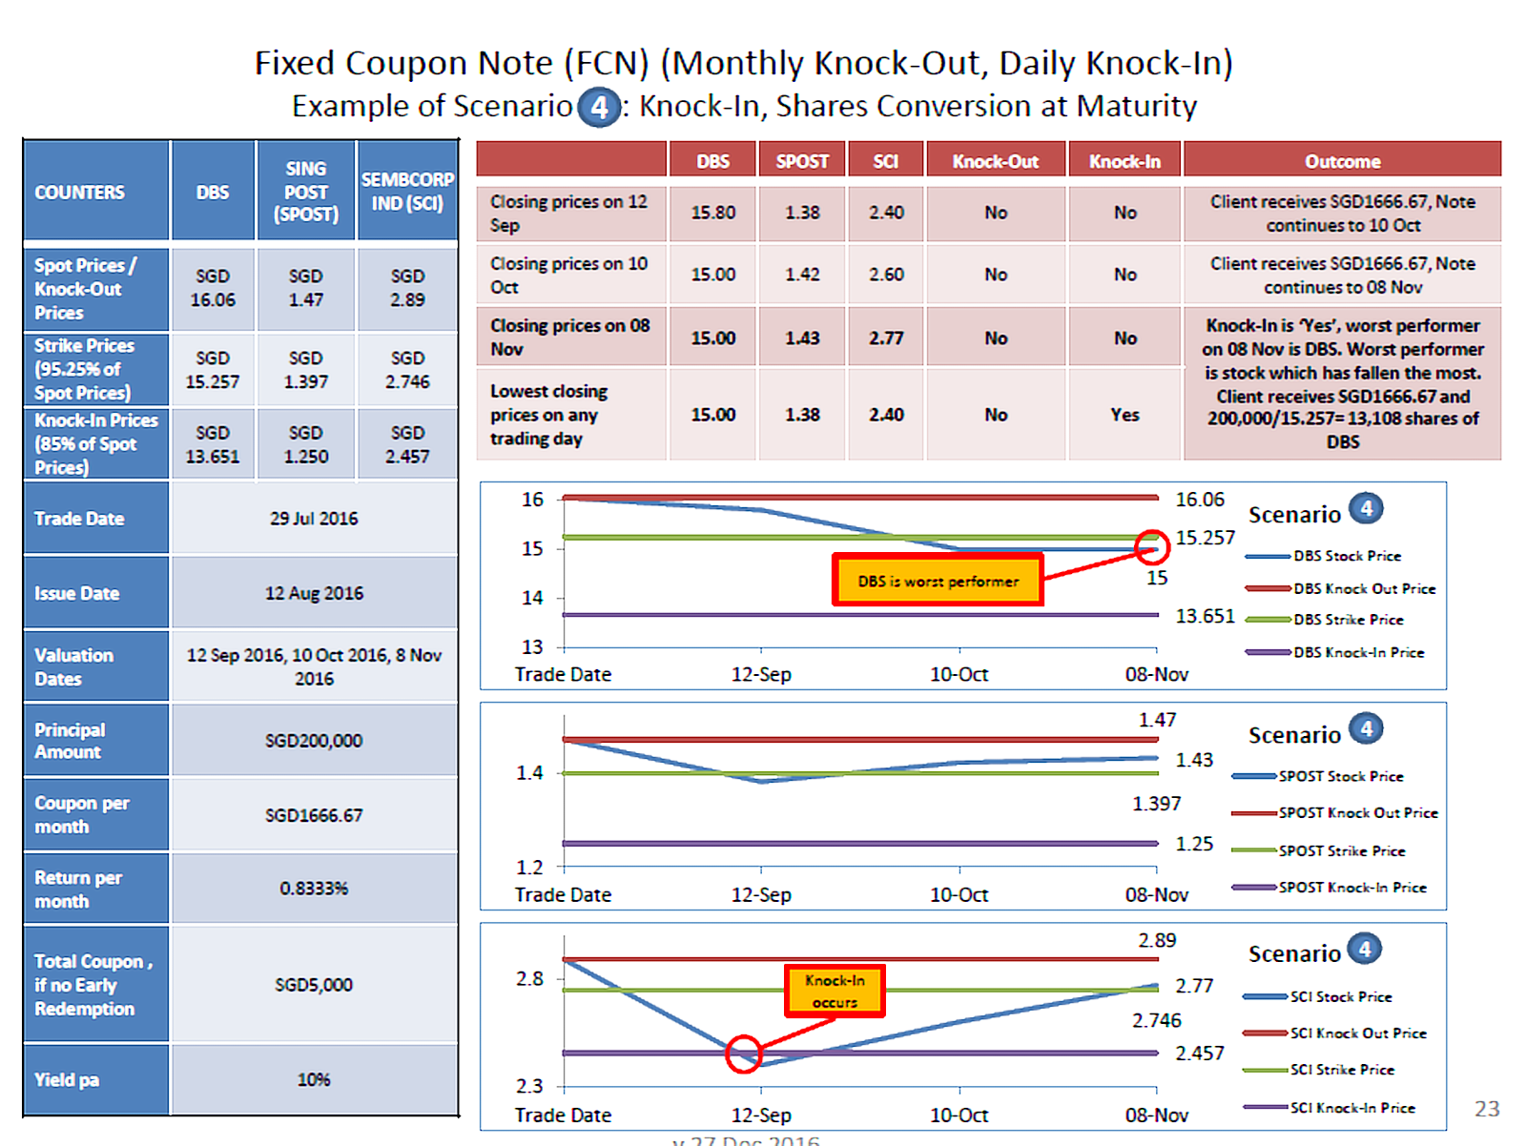

Slide 15
BENEFITS
Receive regular coupon payments.
In case of a knock-out, get your money back early and reinvest directly in the market.
RISKS
Your principal is not protected.
Gains are limited to the pre-decided coupon.
Constant exposure to credit risk of the issuer.

Slide 17
Shares
Shares are units of ownership interest in a corporation or financial asset that provide for an equal distribution in any profits, if any are declared, in the form of dividends.
The two main types of shares are common shares and preferred shares.
Preference share is a share which entitles the holder to a fixed dividend, whose payment takes priority over that of ordinary share dividends.
Common shares are securities representing equity ownership in a corporation, providing voting rights, and entitling the holder to a share of the company's success through dividends and/or capital appreciation.

Slide 18
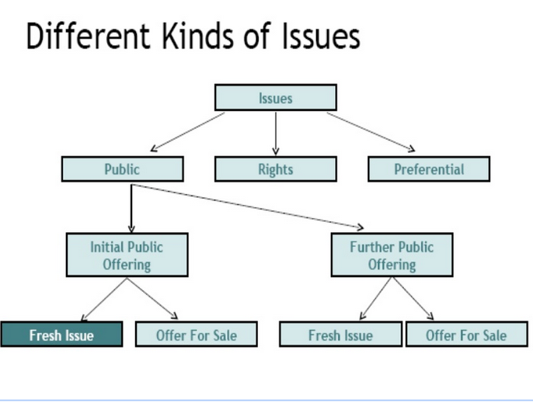

Slide 19
Voluntary & Non Voluntary Corporate Actions
A mandatory corporate action is an event initiated by the corporation by the board of directors that affects all shareholders.
Participation of shareholders is mandatory for these corporate actions.
Mandatory Corporate Actions Includes Cash Dividend, Stock Splits, Mergers, Bonus Issue and Spinoffs.
Voluntary corporate actions, are actions requiring a decision from the investor on whether or not to participate. Example Right Issues and Buyback etc.

Slide 20
Dividends
Cash Dividend
Companies are not required to pay dividends. Companies that choose to do so, often have grown sufficiently and see no opportunities to invest in themselves to obtain growth.
The company’s board of directors decides what percentage of earnings will be paid out to shareholders, and puts the remaining profits back into the company. Although dividends are dispersed quarterly, it is important to remember that it’s not necessary for a company to pay dividend every single quarter.
Important dates in case of dividend payout:
Declaration Date: This is the date on which a company’s board of directors declares that a dividend will be paid. The board determines the amount of the dividend, as well as when it is to be paid to shareholders of record.
Record Date: This is the date on which a company reviews its books to determine its shareholders of record. Shareholders who hold a particular stock on this date will receive the firm’s dividend payment.
Ex-Dividend Date: The ex-dividend date for stocks is typically two business days prior to the record date. If an investor buys a stock before the ex-dividend date, then he or she will receive the dividend payment else they wouldn’t receive.

Slide 21
Stock Dividend
Also known as scrip dividend. Paid in additional stocks rather than cash
When - Either there is a shortage of liquid cash or it wants to hold onto its existing liquidity for other investments
Advantageous for shares holders who don’t need immediate cash
Tax advantage
Dividend reinvestment:
In a dividend reinvestment scenario, dividend distributions are reinvested back into the investor's account and used to purchase additional shares. This method increases the number of shares owned over time and typically results in the account growing in value at a faster rate than if dividends were not reinvested. Many investment companies offer this service to shareholders at no cost

Slide 22
Warrants
Similar to options. We have both call and put warrants. There are both American and European warrants.
Issued by the company itself. They are traded over the counter more often than exchange.
Warrants are dilutive: when an investor exercises her warrant, she receives newly issued stock, rather than already-outstanding stock. Warrants have long period of maturities in years rather than in months.

Slide 23
Rights issue
Rights are issued by cash strapped companies.
Offers discount on existing share price .Transaction is executed on strike price.
Offering ratio: No of rights issued/ Total existing shares holding.
Ex-right price = (market cap of existing shares + no of new shares *strike price)/ Total shares after exercising the rights.
You can
subscribe to the rights issue in full (At strike price),
ignore your rights or
sell the rights to someone else
Non renounceable rights cant be transferred or sold to others. While renounceable rights (called nil-paid rights after transferred) can be transferred at a price.
Price=(ex right price – strike price)
There is open offer similar to rights issue with only one conspicuous difference: shares purchased under offer cant be sold.

Slide 24
Bonus issue
Both : cash and shares
Cash bonus is paid against overtly gained profits in a quarter.
Shares bonus is issued freely when company has paucity of cash flow to meet dividends requirements. Increasing outstanding shares decreases stock price.
Shareholders can sell these bonus shares to meet their liquidity requirements.
Bonus issued is accord to some offering ratio .For eg 100 bonus shares for 1000 holding shares.

Slide 25
Spin-Off
A spinoff is creation of an independent company through the sale or distribution of new shares of an existing business or division of a parent company.
Undertaken by company to streamline their business by spinning off less profitable or unrelated ventures.
Spin off procedures:
A corporation creates a spinoff by distributing 100% of its ownership interest in that business unit as a stock dividend to existing shareholders.
Offer its existing shareholders a discount to exchange their shares in the parent for shares
of the spinoff.

Slide 26
It is common for the stock price of the parent company to take an immediate dip.
Assets that now belong to the subsidiary were removed from the parent company's books, which lowers its book value.
However, the value of the subsidiary's shares tend to make up the difference; the sum of the two stock prices typically approximates the parent company's pre-spinoff stock price.
Post spin off market capitalisation of parent + post spin off maket cap of subsidiary = pre spinoff price

Slide 27
Buybacks
Purchase by a company of its outstanding shares that reduces the number of its shares in the open market.
Process for buyback
Tender offer to shareholders to sell stocks at a premium in the given time frame.
Company can buy in open market
There can be deployment of cash for buybacks or resorting to leverage buybacks or combination of both.
Expanded repurchase plan is exceeding the rate of normal buybacks
Effect: Increases earnings per share and elevates the market value of the remaining shares. After repurchase, the shares are cancelled or held as treasury shares, so they are no longer held publicly and are not outstanding.

Slide 28
Tender Offer
The tender offer is a public, open offer or invitation (usually announced in a newspaper advertisement) by a prospective acquirer to all stockholders of a publicly traded corporation (the target corporation) to tender their stock for sale at a specified price during a specified time, subject to the tendering of a minimum and maximum number of shares.
Generally it is at premium and it is subsequent on a condition.
For example, if a target corporation's stock were trading at $10 per share, an acquirer might offer $11.50 per share to shareholders on the condition that 51% of shareholders agree.

Slide 29
Capital Reduction
Capital reduction is the process of decreasing a company's shareholder equity through share cancellations and share repurchases.
Reasons include increasing shareholder value and producing a more efficient capital structure.
Permanent reduction in a firm's scale of operations, or revenue losses that cannot be recovered from the firm's earnings
A notice must be sent out to creditors of the resolution of the capital reduction

Slide 30
Stock Splits and reverse stock splits
Division of an existing share into multiple shares by a specific multiple. Price per stock decreases but market value remains same theoretically.
Generally the greater liquidity and higher demand of the share will typically drive the share price up, thereby increasing the company's market capitalization and value.
Split is usually undertaken when the stock price is quite high, making it pricey for investors to acquire
Second, the higher number of shares outstanding can result in greater liquidity for the stock, which facilitates trading and may narrow the bid-ask spread
Consolidation of multiple shares into one. For example 10 shares to 1.(10:1)
Stock price rises because of reverse stock split but the market cap remaining same.

Slide 31
Merger
A merger is a deal to unite two existing companies into one new company.
Mergers and acquisitions are commonly done to expand a company’s reach, expand into new segments, or gain market share
When the merger is stock-for-stock, the acquiring company simply proposes to the target firm a payment of a certain number of its equity shares in exchange for all of the target company's shares
The exchange ratio is the relative number of new shares that will be given to existing shareholders of a company that has been acquired or has merged with another.
Idea and Vodafone merger

Slide 32
Acquisition
In the case of an acquisition, a company seeks out and buys a majority stake of a target company's shares.
The acquiring company's stock typically falls during an acquisition. Since the acquiring company must pay a premium for the target company, they may have exhausted their cash or had to use a large amount of debt to finance the acquisition.
Stock prices of potential target companies tend to rise well before a merger or acquisition has been announced. Prices rise due to premium is paid by acquiring company.
Airtel acquisition of Telenor

Slide 33
Initial Public Offer
An initial public offering is when a private company or corporation raises investment capital by offering its stock to the public for the first time.
In an initial public offering, the issuer, or company raising capital, brings in an underwriting firm or investment bank, to help determine the best type of security to issue, offering price, amount of shares and timeframe for the market offering.
Reason include
Gives the company a lower cost of capital
Raises the largest amount of money for the company compared to other options

Slide 34
Further Public Offering
An FPO is a stock issue of additional shares made by a company that is already publicly listed and has gone through the IPO process.
It is done to raise capital to expand or pay off debt.
Two main types of follow-on public offers
The first is dilutive to investors, as the company’s Board of Directors agrees to increase the share float level or the number of shares available.
The other type of follow-on public offer is non-dilutive. This approach is useful when directors or substantial shareholders sell off privately held shares. With a non-dilutive offer, all shares sold are already in existence. Commonly referred to as a secondary market offering, there is no benefit to the company or current shareholders.

Slide 35
Offer for sale(OFS)
An offer-for-sale is different from an IPO and an FPO in the sense that an OFS does not result in fresh raising of funds.
OFS, an existing shareholder usually promoter dilutes their stake in the company through the primary market sale.
An OFS only results in a transfer of ownership from one shareholder to another and does not increase the share capital of the company.
Physical Application: Unlike IPOs/FPOs, no physical forms/prospectus are required to apply for shares in OFS.

Slide 36
Time Period: While IPO/FPO issues remain open for three-four days, an OFS gets over in a single trading day.
Charges: Investors are not required to pay any fee in IPOs/FPOs. But buying in OFS involves payment of brokerage, securities transaction tax and other charges that investors pay when they buy shares in the cash market
Also, an investor can put multiple bids above the floor price set by the company, unlike in IPOs, where the bid price cannot be more than one. He can also modify/cancel the bid anytime during OFS market hours

Slide 37
Liquidation payment/dividends
Liquidation is the process of bringing a business to an end and distributing its assets to claimants.
Occurs when a company is insolvent, meaning it cannot pay its obligations as and when they come due.
Assets are distributed based on the priority of various parties
Secured creditors > unsecured creditors >preferred stock holders> common stock holders

